Slide 1
Earning CE Credits at the NYSPA Convention

Slide 2
The Foundation of the New York State Psychological Association, Inc. is recognized by the New York State Education Department’s State Board for Psychology as an approved provider of continuing education for licensed psychologists #Psy-0066.
The Foundation of the New York State Psychological Association is approved by the American Psychological Association to sponsor continuing education for psychologists. The Foundation of the New York State Psychological Association maintain responsibility for this program and its content.

Slide 3
SIGN-IN & SIGN-OUT REQUIRED
You must sign-in within the first 15 minutes of the session and sign-out at the conclusion of the session.
Please check in with the NYSPA Staff Member stationed in or outside of the session room to sign in/out.

Slide 4
SESSION EVALUATION REQUIRED
You must complete and submit a session evaluation prior to leaving the session.
Session evaluations will be distributed at the conclusion of the Q&A period.

Slide 5
CERTIFICATES OF COMPLETION
Certificates of completion will be emailed out to attendees no later than three weeks after the conclusion of the Convention.

Slide 6
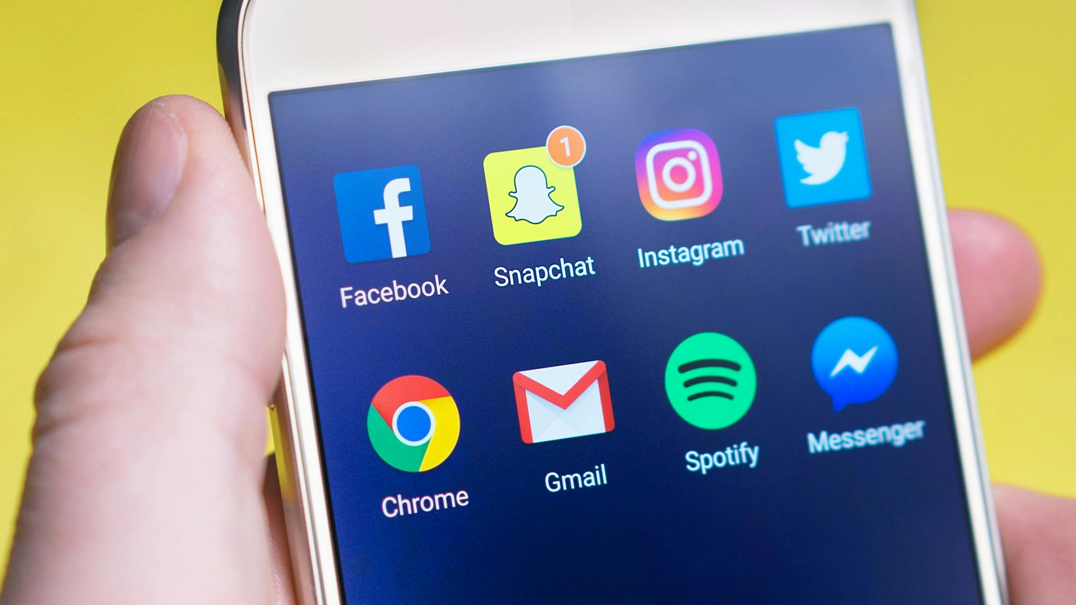

Slide 7
Ethical Considerations and Risks of Professional Social Media Accounts

Slide 8
Quinn Austin-Small, PhD
New York State Psychologist License #: 021191
Connecticut State Psychologist License #: 4391
UK HCPC Registration, Clinical & Forensic Designations, PYL040403
Diplomate, American Academy of Experts in Traumatic Stress
Owner, Austin-Small Consulting & ASCPD
www.qasphd.com
www.psychcpd.com/

Slide 9
Objectives
1
2
3
4
Learners will be able to at least 3 potential financial, reputational, organizational, and legal risks of social media engagement.
Learners will be able to state at least 3 empirically validated findings regarding the impact of mental health-related social media on consumers.
Learners will be able to identify at least 4 ways social media engagement relates to the APA and State ethics codes.
Learners will be able to describe and implement at least 2 ways to reduce their own risk when engaging in social media presence.

Slide 10
Brief History of Social Media
Notes:
Let’s have a brief history of social media. Back in the late 80s and thru the late 90s, social media tended to be mostly message boards. People wrote long-form posts that could be read by anyone, organized into threads. Identities could be anonymous, multiple screen names were common. Very few, if any pictures.
Interactive 1: Why do psychologists use social media?

Slide 11
Notes:
Let’s have a brief history of social media. Back in the late 80s and thru the late 90s, social media tended to be mostly message boards. People wrote long-form posts that could be read by anyone, organized into threads. Identities could be anonymous, multiple screen names were common. Very few, if any pictures.
Interactive 1: Why do psychologists use social media?

Slide 12
Notes:
Let’s have a brief history of social media. Back in the late 80s and thru the late 90s, social media tended to be mostly message boards. People wrote long-form posts that could be read by anyone, organized into threads. Identities could be anonymous, multiple screen names were common. Very few, if any pictures.
Interactive 1: Why do psychologists use social media?

Slide 13
Notes:
Interactive 1: Why do psychologists use social media?

Slide 14
“Once identified as a psychologist, creators are representing the profession and what they say reflects on psychology.” - Lindsay Childress-Beatty, JD, PhD, APA’s Chief of Ethics

Slide 15
Ethics Guidelines Overview
ASPPB established a Social Media Task Force (SMTF) in late 2017
Psychologists maintain confidentiality in creating, storing, accessing, transferring, and disposing of records under their control relating to their professional social media use.
Psychologists use security measures to protect information kept on social media that is vulnerable to loss, damage, or to inappropriate access.
Psychologists are cautious about making posts to public comment sites, especially those related to their worksite / employer.
Psychologists strive, to the extent possible, to maintain their personal online presence distinct from their professional online presence.
Psychologists maintain clear boundaries between their professional and personal social media accounts.
Psychologists use trusted and secure networks to access professional social media accounts.
APA began researching in 2019, published their Guidelines in 2021
Guidelines are broad, generally non-specific.
Psychologists consider the need to avoid contact with their current or past clients on social media, recognizing that it may blur boundaries of the professional relationship.
Psychologists are mindful of the public nature of social media and that their privacy and confidentiality often are not protected nor expected on social media.
Psychologists are aware of the benefits of establishing a policy regarding their participation in social media and discussing this policy and their use of social media as part of the informed consent process with clients.
APA Ethics still apply
Principle A: Beneficence and Nonmaleficence
Principle B: Fidelity and Responsibility
Principle C: Integrity
Principle D: Justice
Principle E: Respect for People's Rights and Dignity

Slide 16
Specific New York State Highlights
Entire Part 29 Rules can be found at: https://www.op.nysed.gov/title8/rules-board-regents/part-29
“Directly or indirectly offering, giving, soliciting, or receiving or agreeing to receive, any fee or other consideration to or from a third party for the referral of a patient or client or in connection with the performance of professional services”.
“Failing to make available to a patient or client, upon request, copies of documents in the possession or under the control of the licensee which have been prepared for and paid for by the patient or client”
“Revealing of personally identifiable facts, data or information obtained in a professional capacity without the prior consent of the patient or client, except as authorized or required by law.”
“Advertising or soliciting not in the public interest shall include, but not be limited to, advertising or soliciting that:
is false, fraudulent, deceptive or misleading;
guarantees any service;
makes any claim relating to professional services or products or the cost or price therefore which cannot be substantiated by the licensee, who shall have the burden of proof;
makes claims of professional superiority which cannot be substantiated by the licensee, who shall have the burden of proof; or
offers bonuses or inducements in any form other than a discount or reduction in an established fee or price for a professional service or product.”

Slide 17
Some Research Findings
Kolmes and Taube (2016) found nearly 70% of the clients surveyed searched for and found personal information about their therapists. Only 27.6% informed their therapists they had done so .
Younger professionals are more influenced by how they believe others will perceive their posts, feel pressure to have a “perfect” online image, and feel “likes” are important and need external validation. (Brown, 2016)
Wu & Sonne (2021) found that non-sexual boundary crossings were fairly common, and psychologists tended to express questions about what was ethical and what wasn’t.
Haney (2014) found writings by individual psychologists usually viewed as reflective of the entire field.
“Greater time spent on social networking websites led to higher psychological distress, an unmet need for mental health support, poor self-rated mental health, and increased suicidal ideation. In conclusion, greater time spent on online social networking promotes self-harm behavior and suicidal ideation in vulnerable adolescents.” Memon, et. Al (2018)
Reviewing patient posts can be problematic- without context or discussion, there is increased risk of “doing harm” by failure to act and sometimes by taking emergency action. (Lehavot, et al, 2012)

Slide 18
Psychologist Risks
Legal & Professional | Financial | Personal | Organizational
Potential liability for effects of posts Liable for messages received Posts can be retrieved later out of context Limited ability to correct information or update after distribution Damage to professional relationships | Increased cost of insurance Lawsuits Cost to maintain sites, storage, etc. Low ROI | Stalking Harassment Increased stress Reputation can be altered long after a post is made Become reliant on external validation | Can incur liability for your employer Damage organizational reputation Create archive burden for the company

Slide 19
Risks to Public
Posts may normalize ill-health rather than promote skills or provide support. | Social contagion | Misinformation | Increase health anxiety, pathologizing behavior
Delay appropriate care | Undermine boundaries, encourage unhealthy relationships/ interpersonal skills | Secondary risk from overexposure | Damage to therapeutic relationship

Slide 20
Reducing Risk
Consider not using social media at all
Limit sites
Distinct and locked personal account, pseudonym for personal account
Ensure liability insurance covers social media
Stick STRICTLY within zone of competence
Be limited and judicious in posting
Consider advertising alternatives
Assume everything is public or can be shared- even listserv / private groups
Turn off messaging
Download and save every message, post, and reply
Create a social media policy for your practice
Keep your personal contact information away from websites, social media, etc.
Remember, the internet is forever

Slide 21
References
American Psychological Association. (2017). Ethical principles of psychologists and code of conduct (2002, amended effective June 1, 2010, and January 1, 2017). https://www.apa.org/ethics/code
Association of State and Provincial Psychology Boards. (n.d.). ASPPB social media guidelines. https://www.asppb.net/page/SMGuidelines
Brown, P. G. (2016). College students, social media, digital identities, and the digitized self (Publication No. 1776598125) [Doctoral dissertation, Boston College]. ProQuest Dissertations and Theses Global.
Drude K, Messer-Engel K. The Development of Social Media Guidelines for Psychologists and for Regulatory Use. J Technol Behav Sci. 2021;6(2):388-396. doi: 10.1007/s41347-020-00176-1. Epub 2020 Nov 2. PMID: 33163619; PMCID: PMC7605462.
Ghorayshi, A. (2024, August 7). On Twitch, mental health support is thriving. But it comes with risks. The New York Times. https://www.nytimes.com/2024/08/07/health/gamers-twitch-mental-health.html
Kolmes, K., & Taube, D. O. (2016). Client discovery of psychotherapist personal information online. Professional Psychology, Research and Practice, 47(2), 147–154. https://doi.org/10.1037/pro0000065
Lehavot, Keren & Phd, Ben-Zeev & E, Robin & Puget, Va. (2012). Ethical Considerations and Social Media: A Case of Suicidal Postings on Facebook. Journal of Dual Diagnosis. 8. 341. 10.1080/15504263.2012.718928.
Medaris, A. (2024, April 1). Ethical gray areas, trolls, and more: Ways to create trustworthy social media content. Monitor on Psychology, 55(3). https://www.apa.org/monitor/2024/04/ethical-social-media-content
Memon AM, Sharma SG, Mohite SS, Jain S. The role of online social networking on deliberate self-harm and suicidality in adolescents: A systematized review of literature. Indian J Psychiatry. 2018 Oct-Dec;60(4):384-392. doi: 10.4103/psychiatry.IndianJPsychiatry_414_17. PMID: 30581202; PMCID: PMC6278213.
New York State Education Department. (n.d.). Part 29: Unprofessional conduct. Office of the Professions. https://www.op.nysed.gov/title8/rules-board-regents/part-29
Oregi P, Cavale N, Khatib M, Rahman SM. The Ethics and Responsibilities of Social Media Usage by Plastic Surgeons: A Literature Review. Aesthetic plastic surgery. 2024;48(3):530-542. doi:10.1007/s00266-023-03553-

